Slide 1
Remote web-based monitoring of the brewing process
Progress Presentation by Matthew King
Notes:
Talk about what who when where why of the project while on this slide give people understanding

Slide 2
Aim and objectives
Main Aim
Produce a system that can be used to monitor the brewing process remotely from a web page via a temperature sensor and a web enable camera
Objectives
Working temperature acquisition system
Raspberry Pi setup for data acquisition from the Arduino system
Completed automatically updating web page and integrated web camera
Completed automatically updating web page with video feed
Completed web page is hosted locally
Completed web page with a working web server solution and port forwarding
To create a light source for the camera that will automatically switch on in dark environments.
To create an email-based update system to notify the user of impending changes that need to be made or problems that need solving time permitting an SMS system could be implemented also.

Slide 3
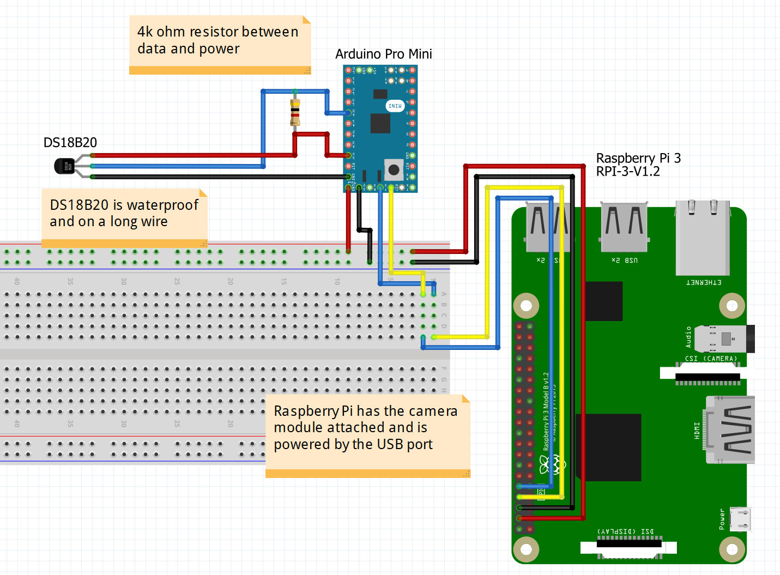
Current State Of the project

Slide 4
Current State Of the project
Building is ahead of Schedule
Working fully soldered Arduino system
Raspberry Pi reads serial communications from Arduino
Raspberry Pi has working camera feed
Raspberry Pi hosts a website on the local network
Website has place holders for temperature readings
Website hosts camera module feed
Don’t have network permissions to use port forwarding

Slide 5
Next steps of the project
Change web server solution to use a JavaScript based service
I will be using Node.js to as the new host to my webserver
This is instead of my current solution apache2
Add in automatically updating data using AJAX and JavaScript
I will be using AJAX to send the updated data to the website
I will switch from python managing my GPIO to JavaScript.
This is to streamline the programming of my project
Making this change will make the project easier to replicate
This change will also make the code easier to read and understand

Slide 6
Are there Any Questions
Thanks for listening

